Slide 1
Student management system
Submitted by,
95072252018
11-MCA

Slide 2
ABSTRACT
Our project Student Management system includes registration of students, storing their details into the system i.e. computerized the process.In the Student Management system Project in python, we will see a project that manages all the information of the students It includes managing data such as name, email-id, contact number, date of birth, which stream they are in, etc.we will build a GUI-based Student Management System Project using the Tkinter, Mysql, messagebox,pycharm an datetime and Ttk modules of the Tkinter library. It is an intermediate-level project, where you will learn how to use databases, and modules and make some great GUIs in Python and apply them in real life. The project file contains a python script (student.py). This is a simple console based system which is very easy to understand and use.

Slide 3
INTRODUCTION
This project is developed mainly to administrate student records.The purpose of the project entitled as STUDENT MANAGEMENT SYSTEM is to computerize the Front Office Management of student records in colleges, schools and coaching’s, to develop software which is user friendly, simple, fast, and cost – effective.Traditionally, it was done manually.The main function of the system is to register and store student details, retrieve these details as and when required, and also to manipulate these details meaningfully. The current system in use is a paper-based system.
Characterstics
Software provides easy management of student records.
Software has very user friendly interface which is very easy to handle and understand.
Software provides security to private data by hiding them.
Software uses very less memory and takes less time to startup

Slide 4
WORKING ENVIRONMENT
PYTHON
Python is a widely used general-purpose, high level programming language. It was initiallydesigned by Guido van Rossum in 1991 and developed by Python Software Foundation. It wasmainly developed for emphasis on code readability, and its syntax allows programmers toexpress concepts in fewer lines of code
PYCHARM
PyCharm is an integrated development environment (IDE) used for programming in Python. It provides code analysis, a graphical debugger, an integrated unit tester, integration with version control systems, and supports web development with Django.
MYSQL
A relational database organizes data into one or more data tables in which data may be related to each other; these relations help structure the dataSQL is a language programmers use to create, modify and extract data from the relational database, as well as control user access to the database.

Slide 5
EXISTING SYSTEM
EXISTING SYSTEM
System Analysis is a detailed study of the various operations performed by a system and their relationships within and outside of the system. During analysis data collected on the various files,decision points and transactions handled by the present system.Analysis begins when a user or manager begins a study of the program using existing system.
Disadvantages
User requirements
Users cannot edit or modify
Information Gathering
Feasibility study
Hacking

Slide 6
PROPSED SYSTEM
PROPOSED SYSTEM
In our proposed system we have the provision for adding the details of the students by themselves. So, the overhead of the school authorities and the teachers is become less. Another advantage of the system is that it is very easy to edit the details of the student and delete a student when it found unnecessary.
Advantages
User friendly interface
Fast access to database
More Storage Capacity
Search facility
Look and Feel Environment
Quick transaction

Slide 7
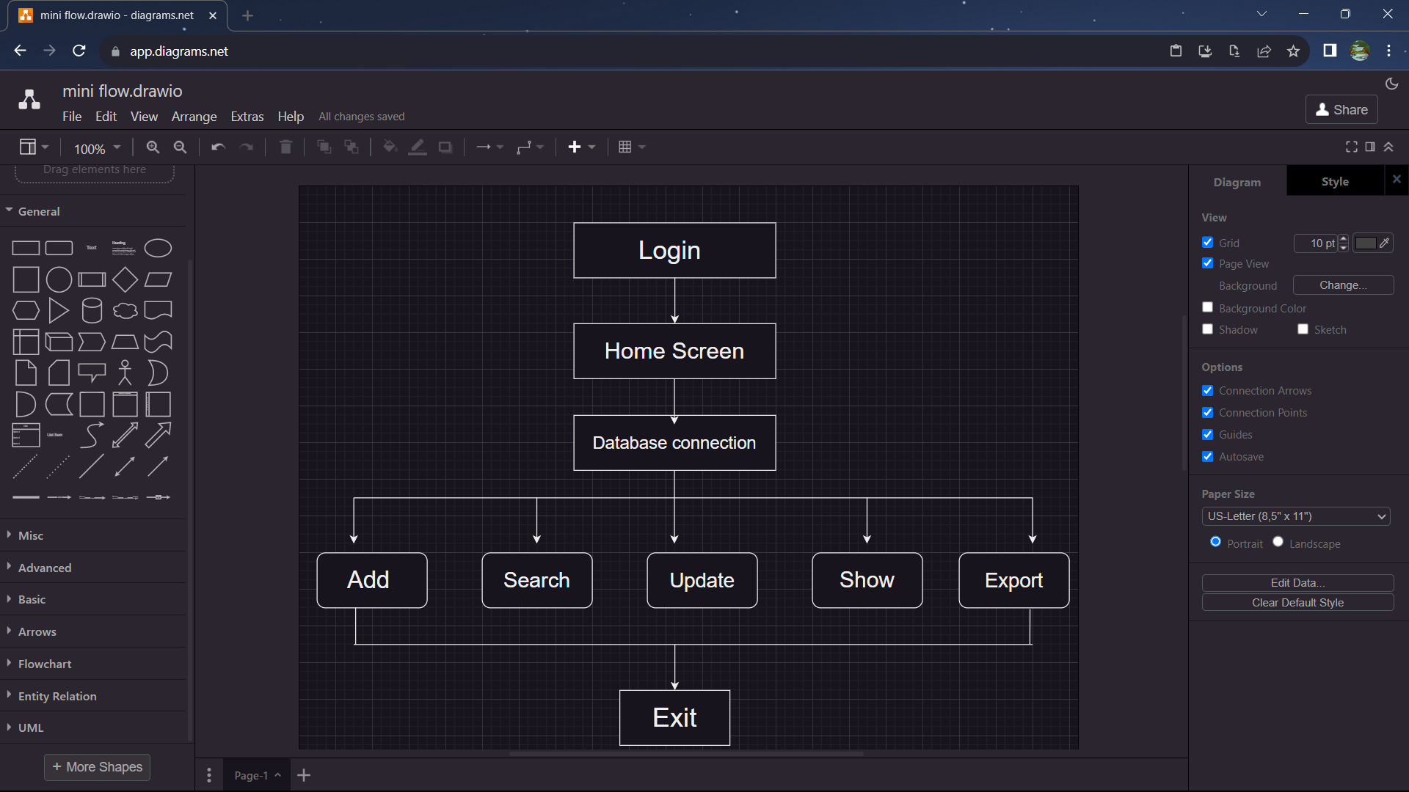
ACTIVITY DIAGRAM

Slide 8
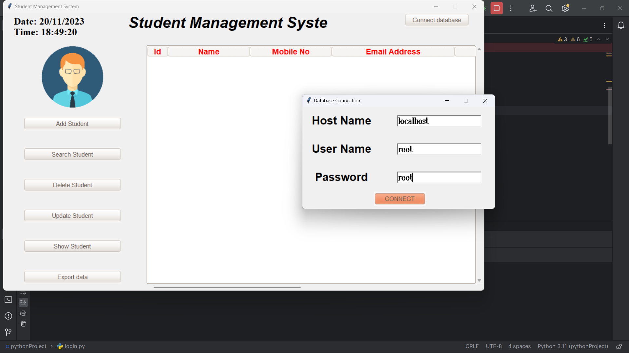
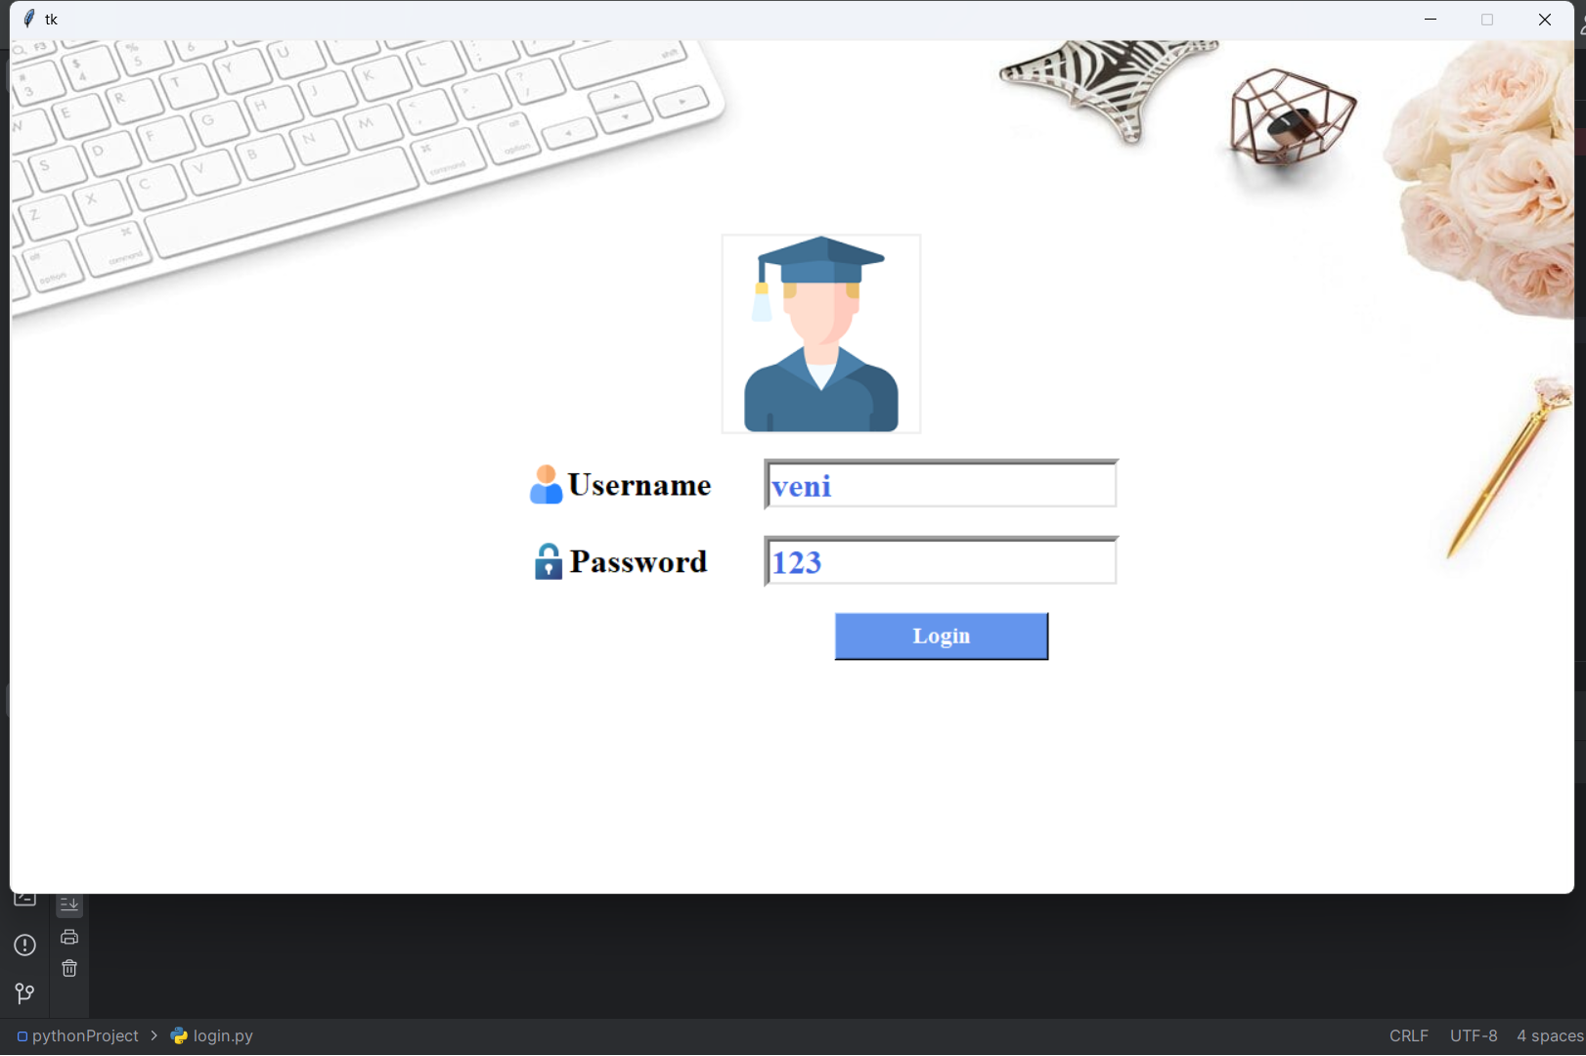
OUTPUT
Database connection
Login page

Slide 9
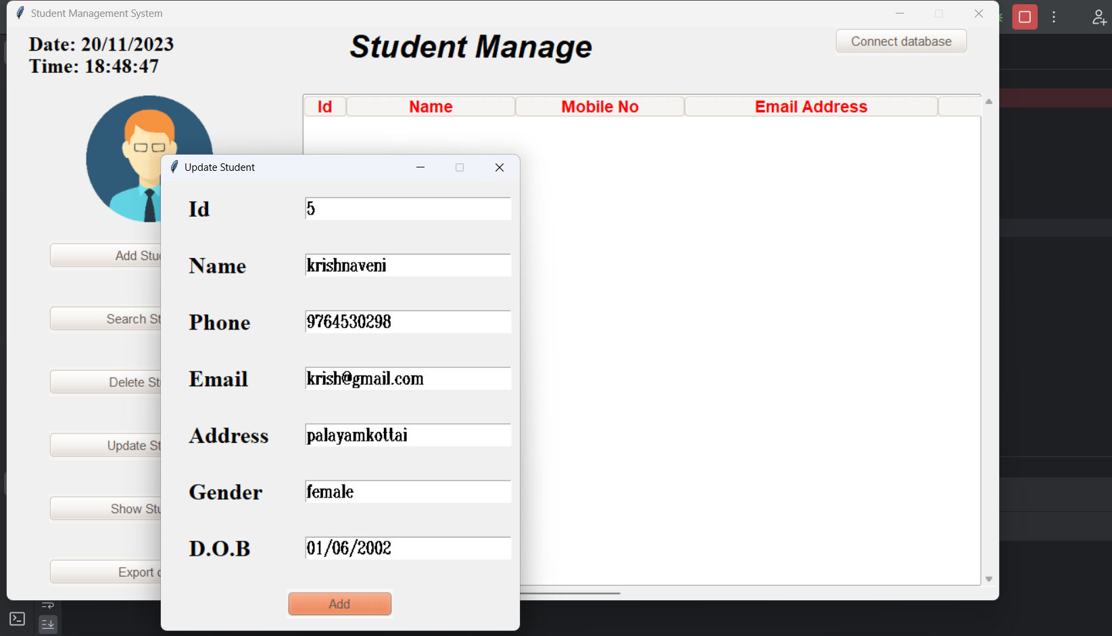
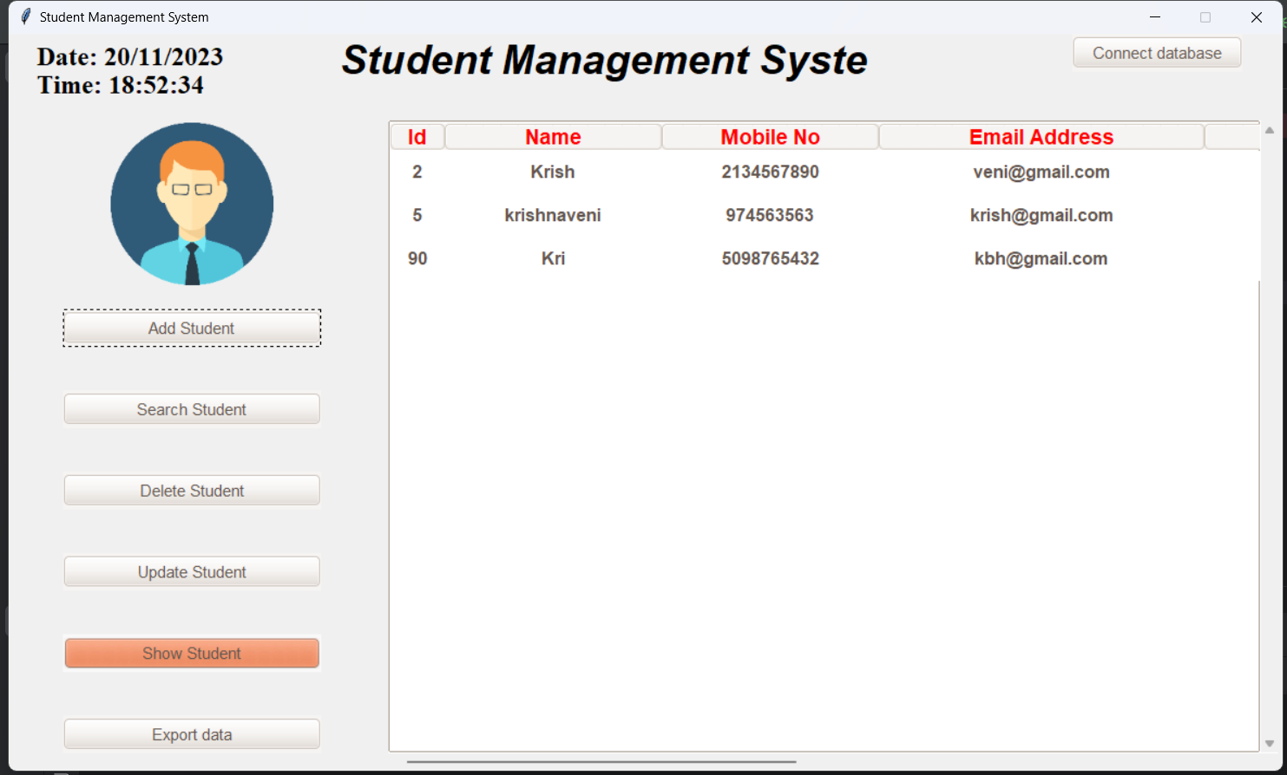
Add student details
Show student details

Slide 10
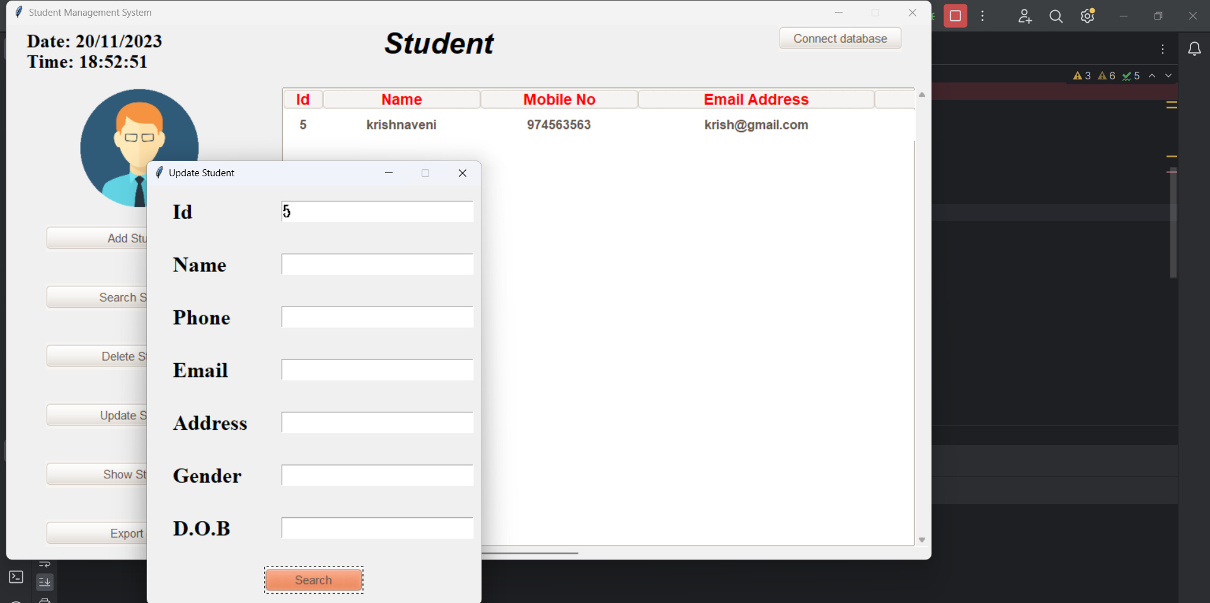
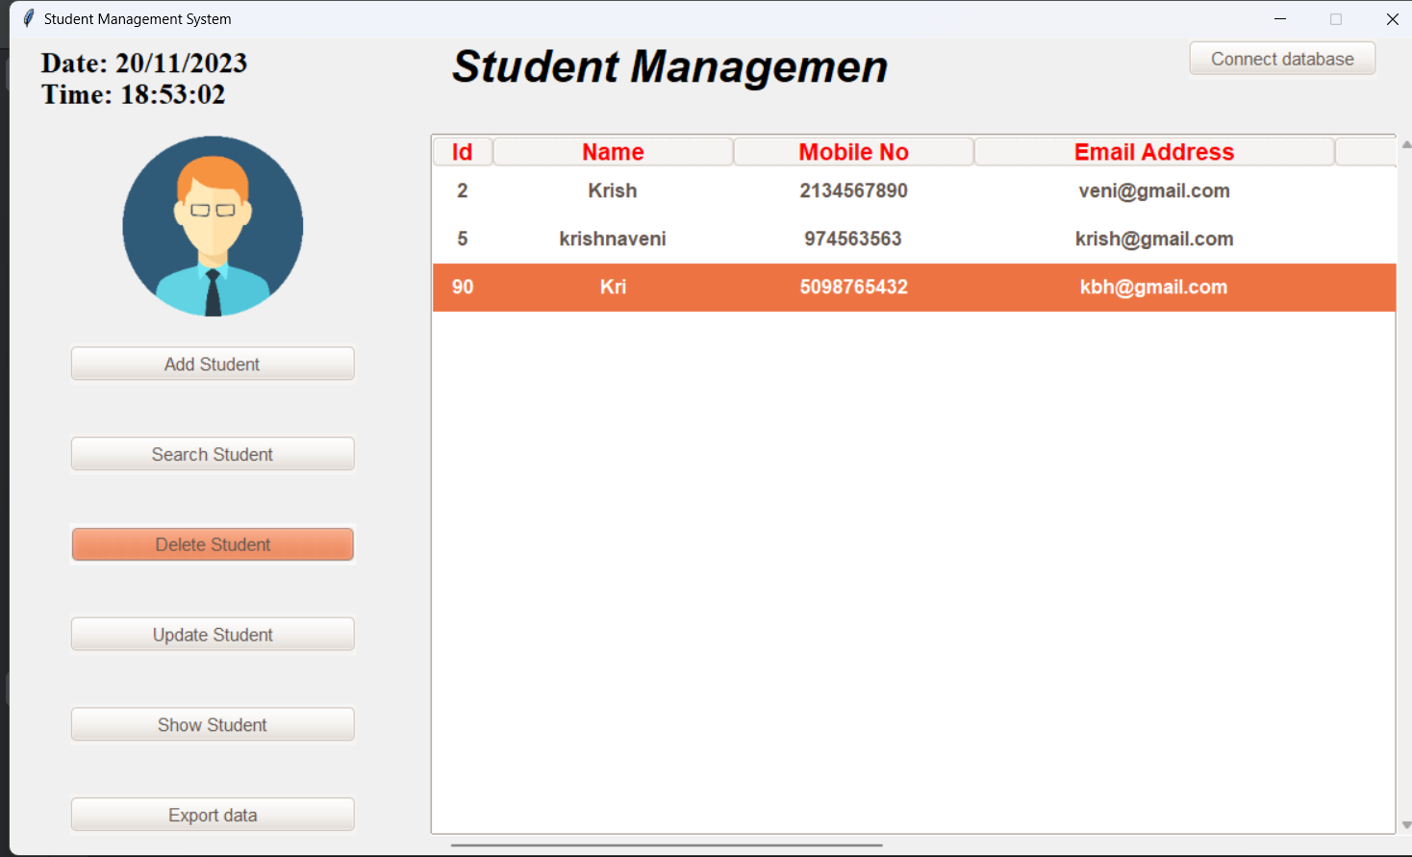
Search students details
Delete student details

Slide 11
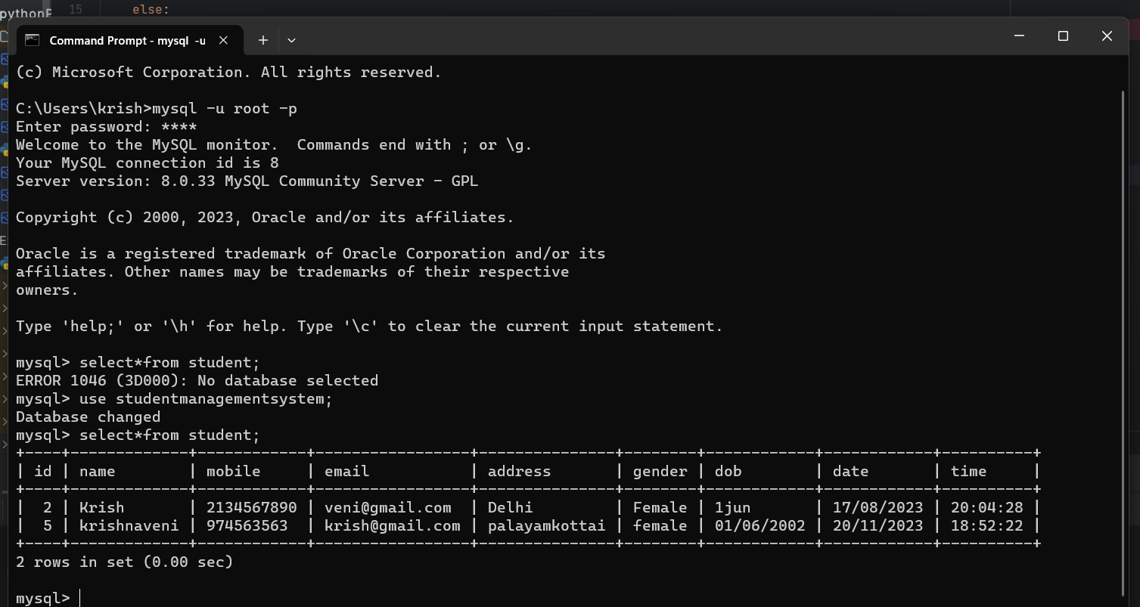
Student database connection

Slide 12
CONCLUSION
The project entitled “Student Management System” is developed using Python Tkinter as front end and MYSQL database in back end to computerize the process of management of student records. This project covers only the basic features required. Student Management System can be used by educational institutions to maintain their student records easily. Achieving this objective is difficult using the manual system as the information is scattered, can be redundant, and collecting relevant information may be very time-consuming.

Slide 13
FUTURE ENHANCEMENT
This Software can be made for all OS.Higher Security features can be included in this software..Program scheduling can also be included in this software.This system can be implemented with OS to reduce overhead of installing and running interface of each and every tool at different place..Automatic Shutdown through SMS service can be implemented in this.Following the testing and deployment of the application, it must be maintained to meet various limitations such as availability, reliability, and so on. Depending on the success or input of the users.

Slide 14
THANKYOU

